Slide 1



Unit –V Part-II
How to Store and Use Bitcoins

Slide 2




Contents
1, 2
3
4
5, 6
7
Simple Local Storage, Hot and Cold Storage.
Splitting and Sharing Keys.
Payment Services and Transaction Fees.
Currency Exchange Markets.
Online Wallets and Exchanges.

Slide 3



.
How to Store and Use Bitcoins
Aim :
To understand practical methods of storing, managing, and using bitcoins securely, while evaluating key management strategies and associated risks..
01
Understand bitcoin storage types: local, hot, and cold wallets.
02
Learn secure key management using hierarchical, brain, and paper wallets
03
Explore address encoding methods like base58 and QR codes.
04
Study cryptographic techniques for key sharing and enhanced security
05
Analyze online wallets, exchanges, transaction fees, and payment services.

Slide 4


Simple Local Storage
How Bitcoins Are Stored
Understanding Local Storage Methods

Slide 5

Simple Local Storage – How Bitcoins Are Stored
What Does It Mean to Store Bitcoins?
• Bitcoins are not files, they are records on the blockchain.
• What you actually store is the private key that gives you access to your coins.
• To spend bitcoins, you need:
o Public Info: blockchain data (coin ID, amount, address)
o Private Key: secret info to authorize spending Real-life Example: Like storing your ATM PIN to access your bank balance.
Goals of Bitcoin Storage
• Availability: Access and use coins when needed
• Security: Prevent unauthorized access or theft
• Convenience: Easy to manage and use
• Challenge: Balancing all three is difficult

Slide 6

Simple Local Storage – How Bitcoins Are Stored
Local Device Storage
Store private keys on:
Laptop/Desktop
Mobile phone
USB or external drive
Advantage: Fast and convenient for everyday use
Risk:
Device loss or damage = lost keys = lost coins
Malware or theft = coins can be stolen Real-life Example: Like carrying cash in your wallet
Wallet Software
Software that:
Manages keys and addresses
Displays balance
Simplifies sending/receiving coins
Generates multiple addresses for privacy
Example Use: Paying for coffee worth $4.25 via app

Slide 7

Simple Local Storage – How Bitcoins Are Stored
Address Encoding Methods
1. Base58 Notation
• Converts binary keys to readable strings
• Omits confusing characters (e.g., 0, O, l, I)
• Example: 1A1zP1eP5QGefi2DMPTfTL5SLmv7DivfNa (Genesis address)
2. QR Codes
• Encodes addresses for easy scanning
• Example: Pay by scanning code at a retail store Visual: Show QR code + Bitcoin address side-by-side
Vanity Addresses
• Custom addresses with readable patterns (e.g., "bones")
• Created by generating millions of keys until one matches desired prefix
• Use Case: Merchants like Satoshi Bones for branding
• Drawback: Computation-heavy process
Real-life Example: Like getting a car number plate that spells your name

Slide 8

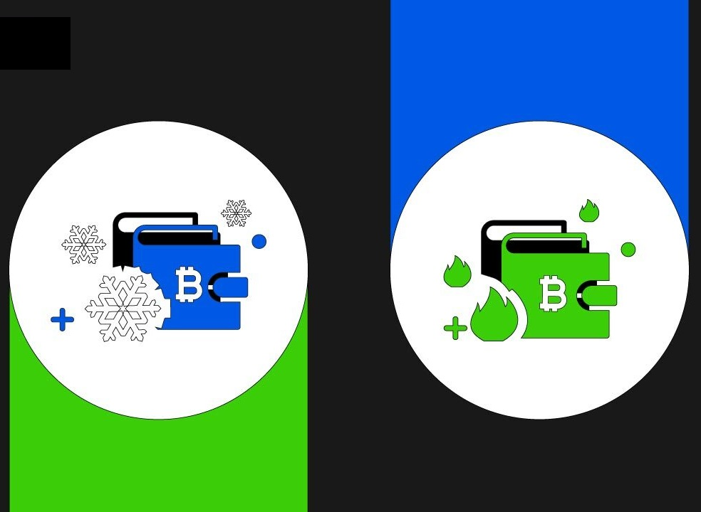
Hot and Cold Storage in Bitcoin

Slide 9
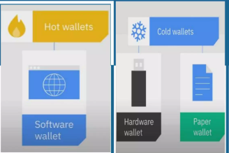
Hot and Cold Storage in Bitcoin
What is Hot Storage?
Definition: Hot storage refers to Bitcoin wallets that are connected to the internet (e.g., software wallets, mobile wallets, exchange wallets).
Real-Life Example: Like carrying cash in your wallet—easy to access but risky if lost or stolen.
Pros: Convenient for daily transactions.
Cons: Vulnerable to hacking, phishing, or malware.
What is Cold Storage?
Definition: Cold storage keeps Bitcoin keys offline, away from internet threats.
Real-Life Example: Like storing savings in a bank vault—safe but less convenient for daily spending.
Pros: Highly secure against cyber threats.
Cons: Slower access for transactions

Slide 10
What is Hot and Cold Storage?
Hot Storage = Online
Cold Storage = Offline
Think of managing your cryptocurrency like managing cash:
Hot Storage is like the cash in your wallet – easy to use, always ready, but at risk if stolen.
Cold Storage is like the money in your locker or bank vault – safer, but not as easy to access.
How Do Hot & Cold Storage Work Together?
Hot Wallet (Online): Used for small, frequent transactions.
Cold Wallet (Offline): Stores large amounts securely.
Example Workflow:
You keep $100 in a hot wallet (like pocket cash).
You store $10,000 in a cold wallet (like a savings account).
If your hot wallet balance grows too large, you transfer excess to cold storage (like depositing cash into a bank).

Slide 11

Managing Cold Storage Addresses
Problem
Cold wallets are offline for security, but we often need new addresses for privacy. Generating them requires going online, which is risky.
Solution 1: Blunt Method
Generate a batch of addresses in advance.
Drawback: Must reconnect wallet to generate more — not secure or scalable.
Solution 2: Hierarchical Deterministic (HD) Wallets
Use a single master seed to derive unlimited addresses.
Only the public key (xpub) is used online; private keys stay offline.
Secure, scalable, and private.
Analogy
Like a master key that can create many unique locks — no need to reveal or reuse the key each time.

Slide 12
Types of Cold Storage
It refers to offline methods of storing cryptocurrency private keys — reducing exposure to online threats like hacking:
📝
A. Paper Wallet
💾
C. Hardware Wallet
🧠
B. Brain Wallet
Let us explore each in details

Slide 13

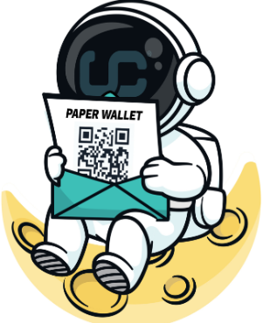
📝 A. Paper Wallet
What it is: A printed copy of your private and public keys or a QR code on paper.
Example: Like writing down your bank password and locking it in a physical safe.
Pros:
Completely offline and immune to online attacks.
Easy to create using trusted tools.
Cons / Security Risks:
Fragile: Paper can burn, fade, or tear.
Theft-prone: If someone finds it, they can steal your funds.
No backup: If lost or destroyed, your crypto is unrecoverable.

Slide 14

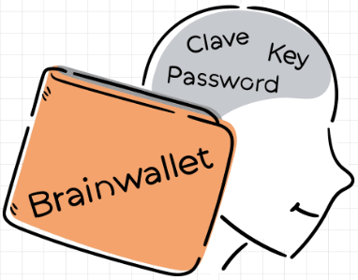
🧠 B. Brain Wallet
What it is: You memorize a passphrase, which is used to generate your wallet’s private key using a hashing algorithm.
Example: Like remembering a secret phrase to unlock a treasure chest.
Pros:
No physical object needed.
Always with you — just your brain.
Cons / Security Risks:
Very risky if you choose a simple or common phrase — easily guessed or cracked.
Memory can fail — if you forget the phrase, your crypto is lost forever.

Slide 15

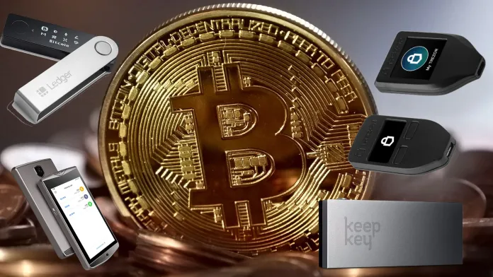
What it is: A USB-like physical device (e.g., Ledger, Trezor) that securely stores private keys and signs transactions internally without exposing keys.
Example: Like a biometric safe that only opens for you — even if stolen, it’s hard to break into.
Pros / Security Benefits:
Highly secure: Keys never leave the device.
User-friendly: Designed for safety and ease of use.
Tamper-resistant: Built-in protections against physical hacking.
Cons:
Cost: More expensive than other methods.
Still needs care: can be lost or damaged if not backed up.
C. Hardware Wallet

Slide 16

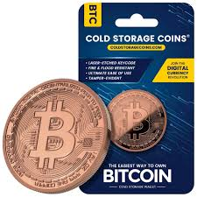
Cold Storage Options with Real-Life Examples
Storage Type | Description | Real-Life Analogy
💾 Offline Device | Turned-off laptop or USB | Safe with a hard drive
🧠 Brain Wallet | Memorized passphrase | Remembering locker combo
📄 Paper Wallet | Keys printed on paper | Bank account info on paper
🔐 Tamper-resistant Device | Hardware wallet (e.g. Ledger) | Smart locker – secure & tamper-proof

Slide 17

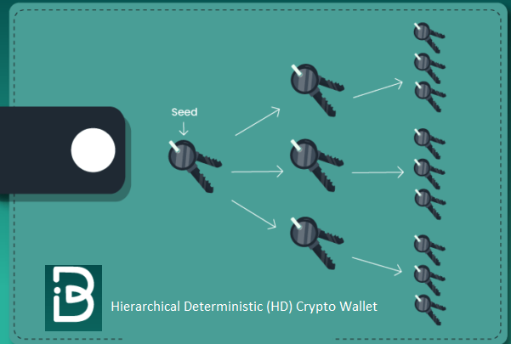
What is a Hierarchical Wallet?
Smart way to manage multiple addresses securely.
Cold wallet creates a master key.
Hot wallet gets address generation info (not private keys).
Hot wallet can create new addresses without compromising security.
More privacy
Less need to reconnect Perfect for large-scale or business use

Slide 18

Splitting and Sharing Keys
How to securely manage Bitcoin keys without a single point of failure

Slide 19

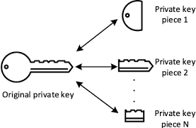
🔐 The Problem with Keeping Keys in One Place
Bitcoin is controlled using private keys.
Storing a key in one place (USB, paper, software) creates a single point of failure.
Backing up keys helps with availability, but increases the risk of theft.
Can we make it both secure and reliable? Yes — with Secret Sharing.
Why It’s Useful
Store shares on different devices/places.
Even if some are stolen or lost, the secret is still safe.
Increases security and availability at the same time.

Slide 20

What is Secret Sharing?
Goal: A method to split a key into N parts (called shares).
You can reconstruct the original key using K out of N shares.
If someone has less than K, they learn nothing.
Rule: Need K shares to reconstruct the key (where K ≤ N).
Example: 2-out-of-2 (N=2, K=2)
Share 1: Random number (R)
Share 2: Secret XOR R
Alone: Each share reveals nothing. Together: XOR to recover the secret.

Slide 21
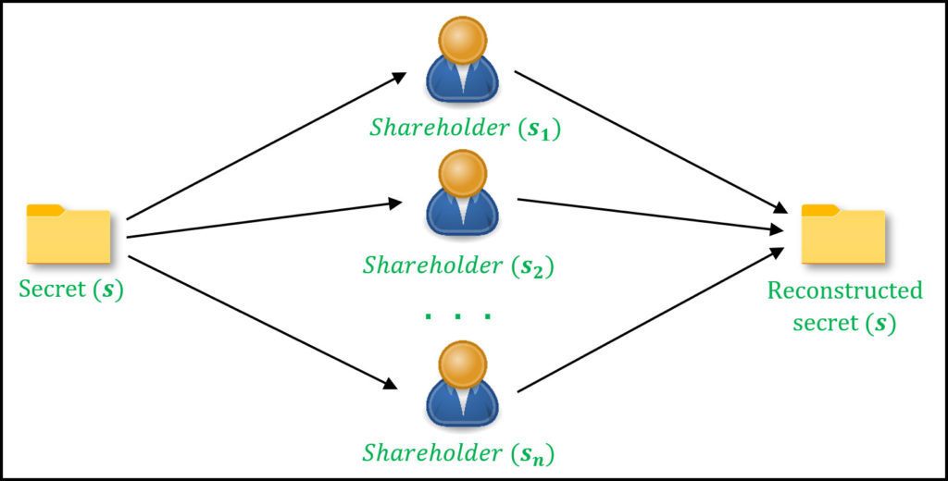
Shamir's Secret Sharing Scheme
Secret Sharing schemes distribute a secret among multiple participants (shareholders).
The secret is divided into fragments called shares.
A single shareholder cannot gain any meaningful information from their share alone.
The original secret can only be reconstructed by combining multiple shares.
This ensures the control of the secret is distributed.
These schemes are examples of Threshold Cryptosystems.
In such systems, a minimum number (threshold) of participants must collaborate to recover the secret.
Depiction of Secret Sharing between n participants

Slide 22
Splitting and Sharing Keys
How Secret Sharing Works
(Real-Life Analogy)
Visual Example – The "Line Trick" (K=2)
Think of a treasure map torn into pieces:
Rule: Need 2 out of 3 pieces (N=3, K=2) to find the treasure.
Piece 1: Hidden in a safe.
Piece 2: Buried in the backyard.
Piece 3: Given to your lawyer.
Why it works:
Lose 1 piece? Recover with the other 2.
Thief steals 1 piece? Useless alone.
Crypto Version: Uses math (XOR or polynomial curves) instead of paper.
Your secret (S) is a point on a graph at (0, S).
Draw a straight line through it with random slope (R).
Pick other points on the line:
(1, S + R) → Save on phone
(2, S + 2R) → Save on USB
(3, S + 3R) → Give to spouse
To get the secret back: Use any 2 points to redraw the line → Find S at x = 0.
Simple idea:
Break your secret into pieces. Any 2 pieces = full secret.

Slide 23
Splitting and Sharing Keys
Flexible Security (Any K and N)
Threshold Signatures
Need stronger security? Use more shares!
Example 1: 2-of-3 for personal use (lose 1 device? Still safe).
Example 2: 3-of-5 for a company (needs 3 execs to approve funds).
Math Magic: Uses polynomial curves (e.g., parabolas for K=3).
Allow signing a transaction without reconstructing the full key.
Example:
Desktop has one share
Phone has another
Both must approve to complete the signature
Helps in 2-factor wallets
Platinum

Slide 24
Multi-Signatures (Multi-sig)
How it works
Why it’s useful
How it works
You create a multi-signature wallet.
You set a rule like “3 of 5”.
This means:
5 people each get their own private key.
Any 3 out of those 5 must agree (sign) to approve a transaction.
Great for companies or teams where no single person should have full control.
It prevents one person from stealing or losing the money.
Makes things more secure and democratic

Slide 25
Multi-Signature Wallet: Example & Benefit
How it works
Why it’s useful
How it works
You create a multi-signature wallet.
You set a rule like “3 of 5”.
This means:
5 people each get their own private key.
Any 3 out of those 5 must agree (sign) to approve a transaction.
Great for companies or teams where no single person should have full control.
It prevents one person from stealing or losing the money.
Makes things more secure and democratic

Slide 26
Multi-Signature Wallet: Example & Benefit
Example
Benefit
Prevents any single person from having full control.
Even if one key is lost or stolen, the funds remain secure.
Increases trust, reduces fraud risk, and allows continued operation even if some members are unavailable.
A company sets up a wallet controlled by 5 managers
Each has a private key.
To approve any fund transfer, at least 3 of them must sign transaction.
If 1 or 2 are unavailable or disagree, the transfer can still go through with the remaining approvals.

Slide 27

Online Wallets & Exchanges

Slide 28

Online Wallets: What are they?
An online wallet is like a digital purse you keep on the internet. Instead of holding cash, it holds your bitcoins or other cryptocurrencies.
Real-Life Example:
Think of Google Photos — you store your pictures in the cloud, not on your phone. Similarly, an online wallet like Coinbase or blockchain.com stores your bitcoins online, and you can access them via a website or an app.
Benefits:
• Easy to use: No need to install complicated software.
• Accessible from anywhere: Just log in from your phone or laptop.
• Syncs across devices: Access your wallet on multiple devices.
Risks:
• Trust issues: Wallet service can access your private keys, which are like secret codes that unlock your money.
• If the website is hacked or the company is dishonest, your bitcoins could be stolen.
• You're trusting someone else to keep your money safe just like handing your wallet to a stranger and hoping they protect it

Slide 29

Bitcoin Exchanges: Like Online Banks
This exchange works a lot like a bank or a stock trading platform, but for cryptocurrencies.
Real-Life Example:
Suppose you use an app like Paytm, PhonePe, or Google Pay to store rupees and make transactions. You don’t hold the physical money — the app just promises to let you spend it when you need it.
Similarly, a Bitcoin exchange like Binance, Coinbase, or Kraken stores your bitcoins and dollars/euros, lets you buy/sell/exchange them, and shows your balance.
How it Works:
• You deposit real money (fiat) or bitcoins into the exchange.
• You can trade: e.g., use $1,000 to buy bitcoins.
• Exchange matches buyers and sellers — no blockchain transaction happens here.
• They just update your account balance internally (like "Now you have 2 BTC, and $200 left").
No blockchain involved in this internal transfer! The exchange simply updates records, similar to how your bank updates your balance.

Slide 30

Pros and Cons of Exchanges
Pros:
You can convert crypto to regular money (and vice versa).
Easy to trade and make payments.
You can manage both fiat and crypto in one place.
Cons (3 Main Risks):
1. Bank Run Risk
Imagine a rumor spreads that bank might shut down — everyone rushes to withdraw their money. If bank doesn't have enough cash, people lose money.
In crypto: If many users try to withdraw at once, exchange might not have enough bitcoins in reserve.
2. Scam Risk (Ponzi Schemes)
Some exchanges might be run by fraudsters. They take new users’ money to pay old users — a typical Ponzi scheme. Eventually, it collapses.
Famous example: Bernie Madoff ran a massive Ponzi scheme in real life.
3. Hacking Risk
Exchanges are a target for hackers because they store large amounts of money. Sometimes, even employees might steal from within.
Real example: Mt. Gox, once the largest Bitcoin exchange, lost over $450 million and went bankrupt due to mismanagement and hacking.

Slide 31


